Slide 1







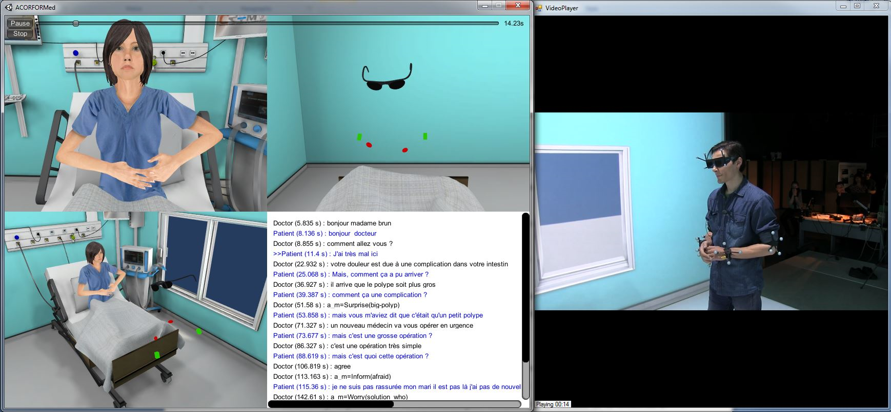


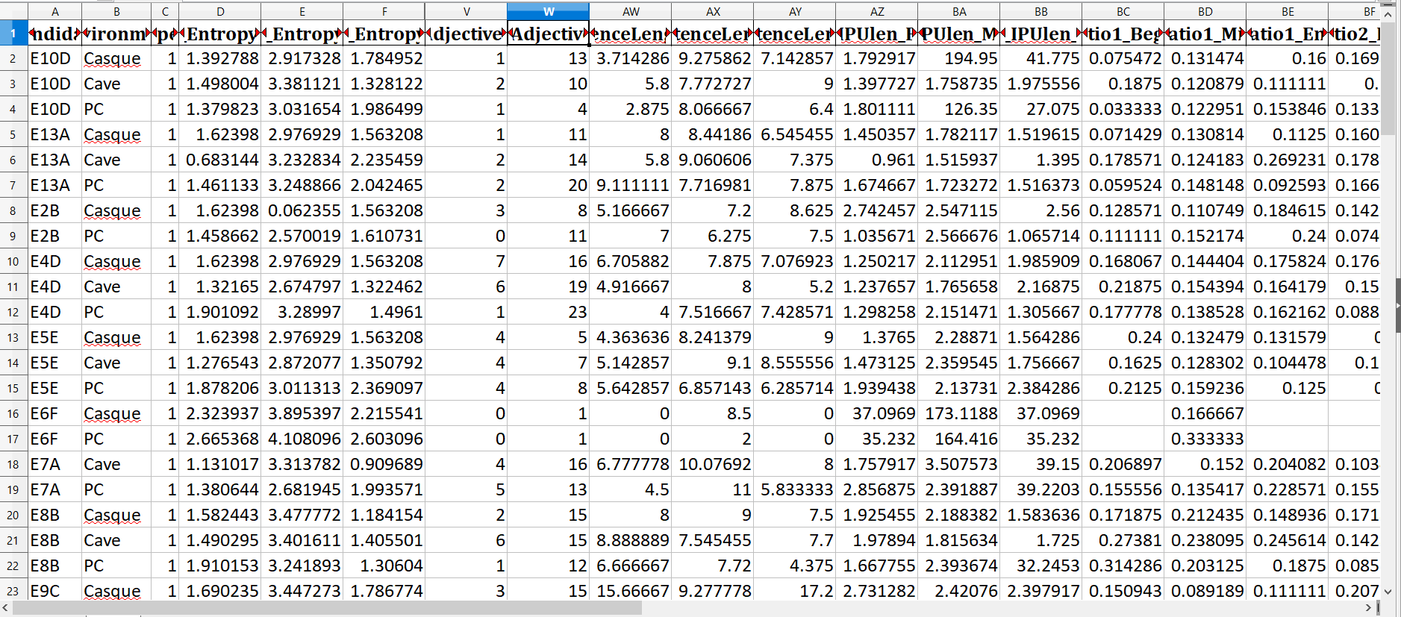
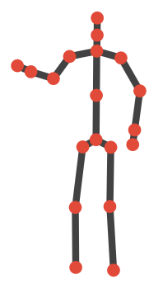
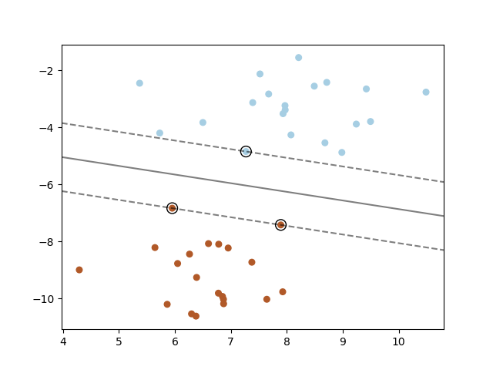
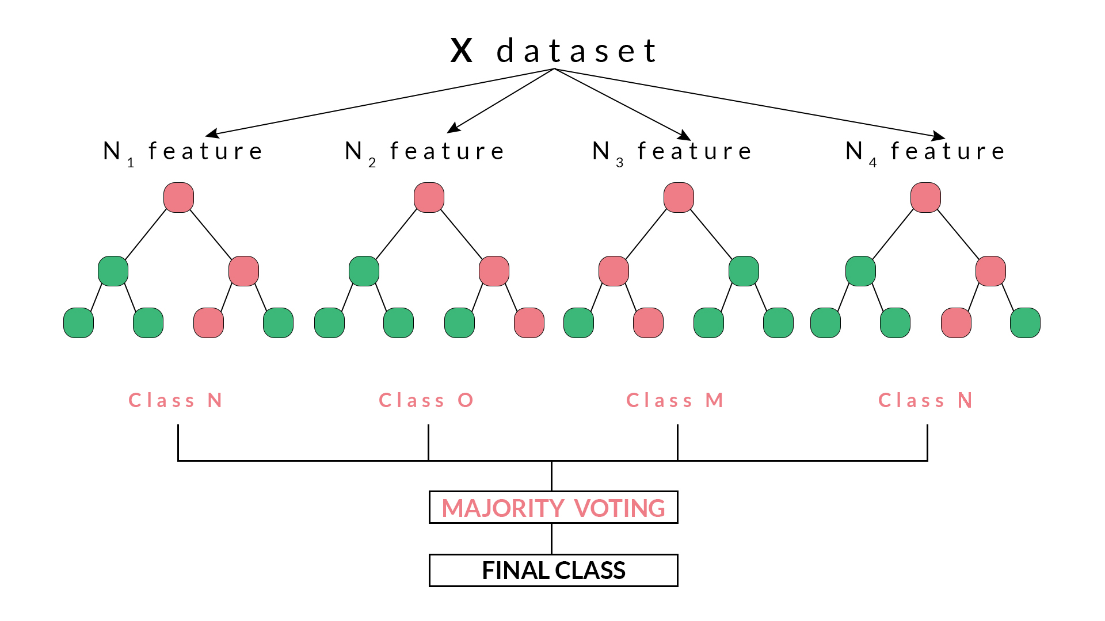
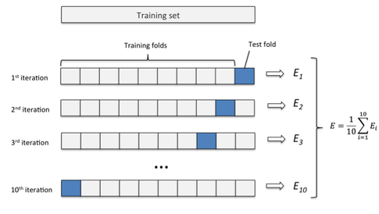
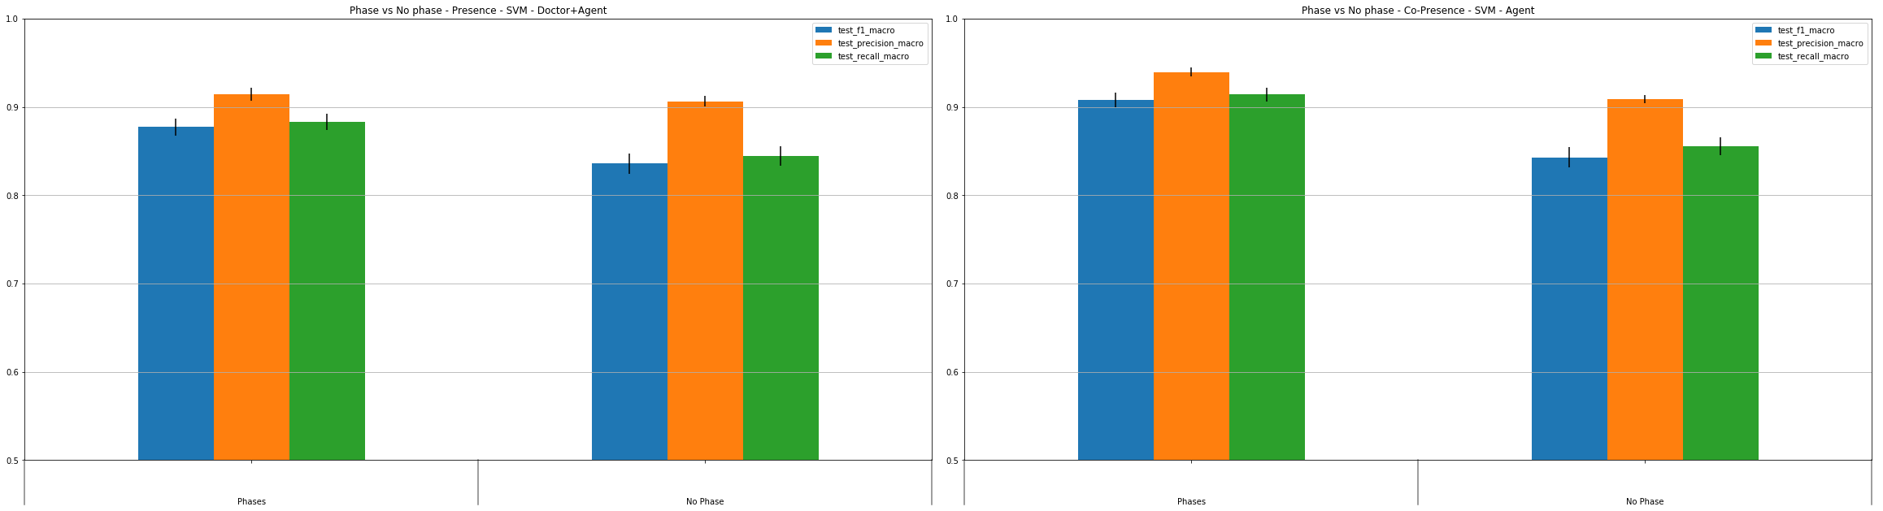
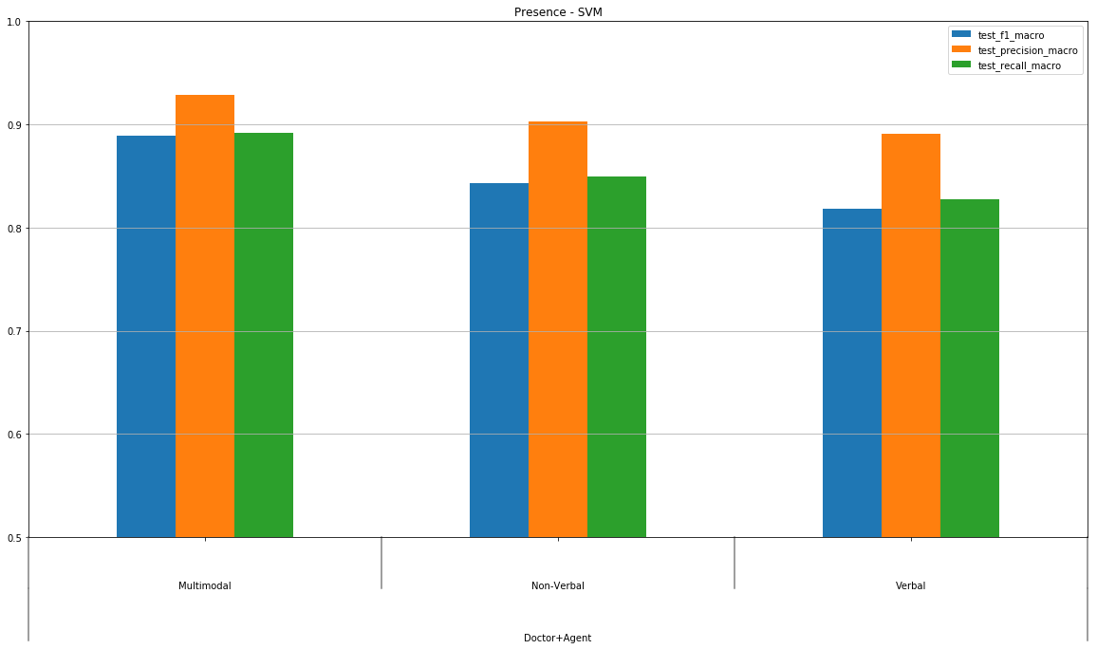
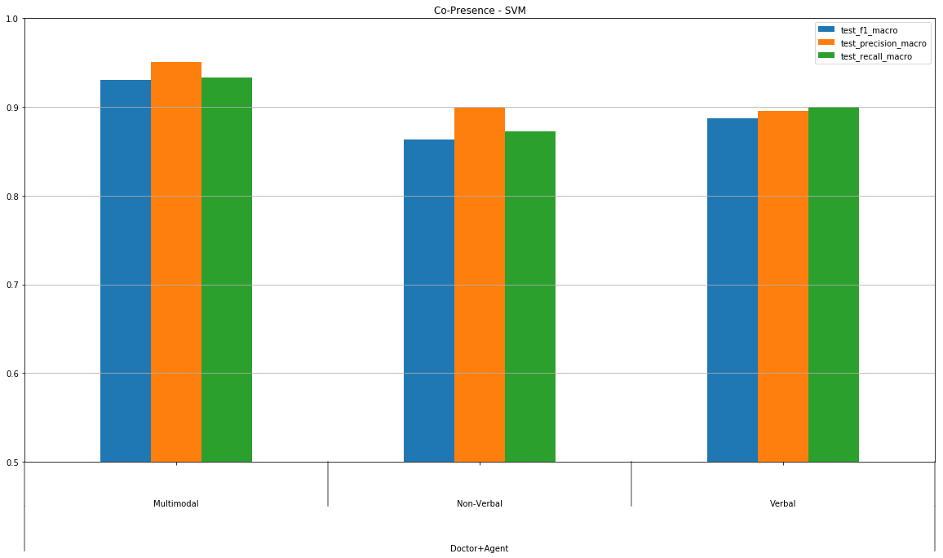
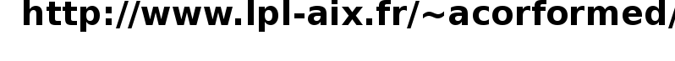
Multimodal cues of the sense of presence and co-presence in human-virtual agent interaction
Magalie Ochs, Philippe Blache, Jérémie Bousquet
Collected corpus of human-machine interaction
Corpus of 108 interactions (36 persons among which 10 doctors) – 6 hours (3mn16/interaction)
video in the three environments (a virtual reality cave, a virtual reality headset, a PC)
time-series three-dimensional unity coordinates of 5 trackers
audio file, transcribed automatically with an ASR system
Tags on videos with presence and co-presence subjective experience of the participants (IPQ post-experience questionnaire) --> low, medium or high sense of (co)presence
Automatic extraction of verbal and non-verbal cues
DATA
Virtual reality environment
with an autonomous virtual patient
Machine-learning training dataset
High-level features for each interaction
Head and Hand mean curve entropy
Lexical richness and linguistic complexity indicators computed thanks to tokens parts-of-speech automatically tagged
Interaction duration, partcipant expertise (doctor or novice), sentences average lengths
All features related to whole interactions, or to interactions timely splitted in 3 phases (introduction, middle, conclusion)
CLASSIFIERS
Experiments on prediction of presence and co-presence class
search of best hyper parameters for the classifiers
10x 10-folds cross-validation
Multimodal cues (verbal, non-verbal)
Segmentation of discourse into 3 phases
Support Vector Machines
Random Forests
MACHINE LEARNING
Segmentation of discourse into phases
Performance scores for the prediction
of presence and co-presence levels
Multimodal cues

Slide 2
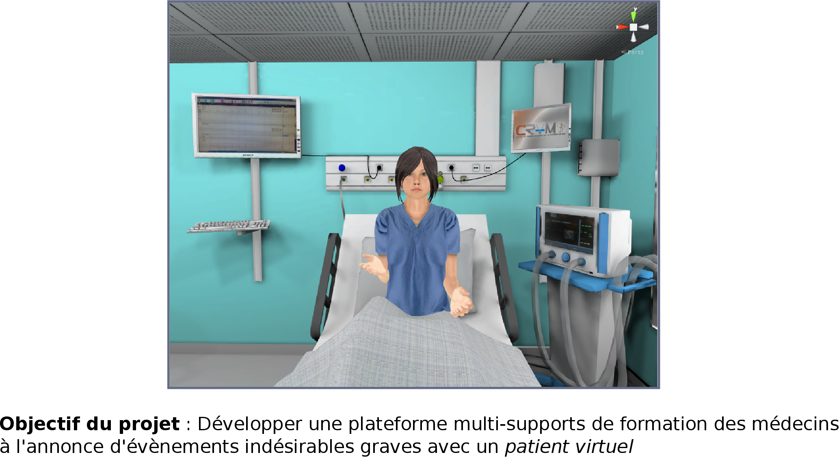
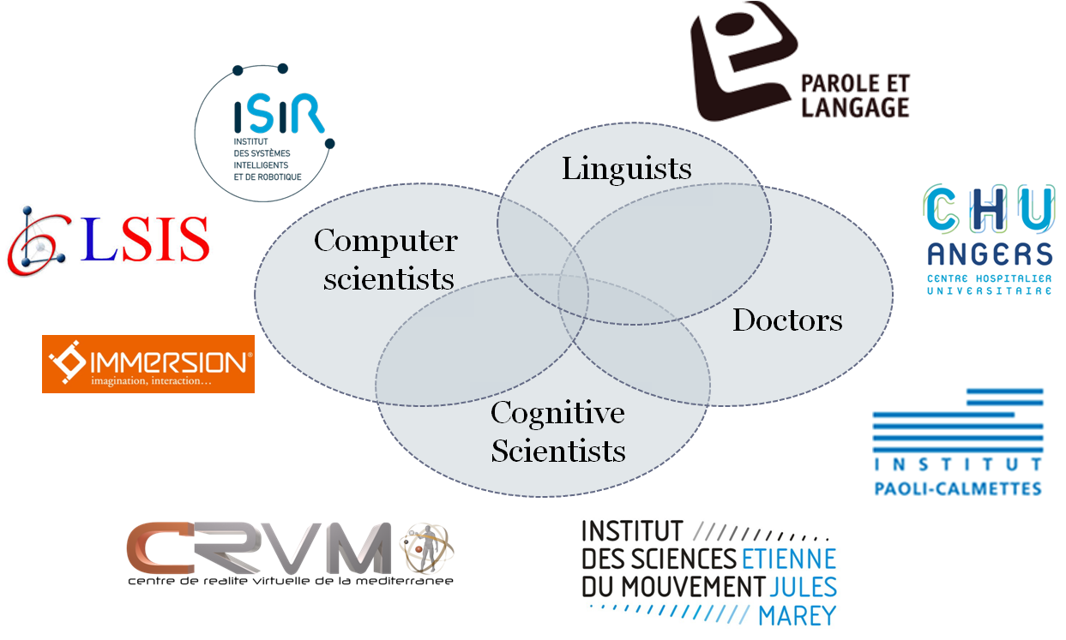
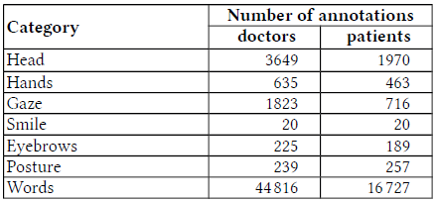
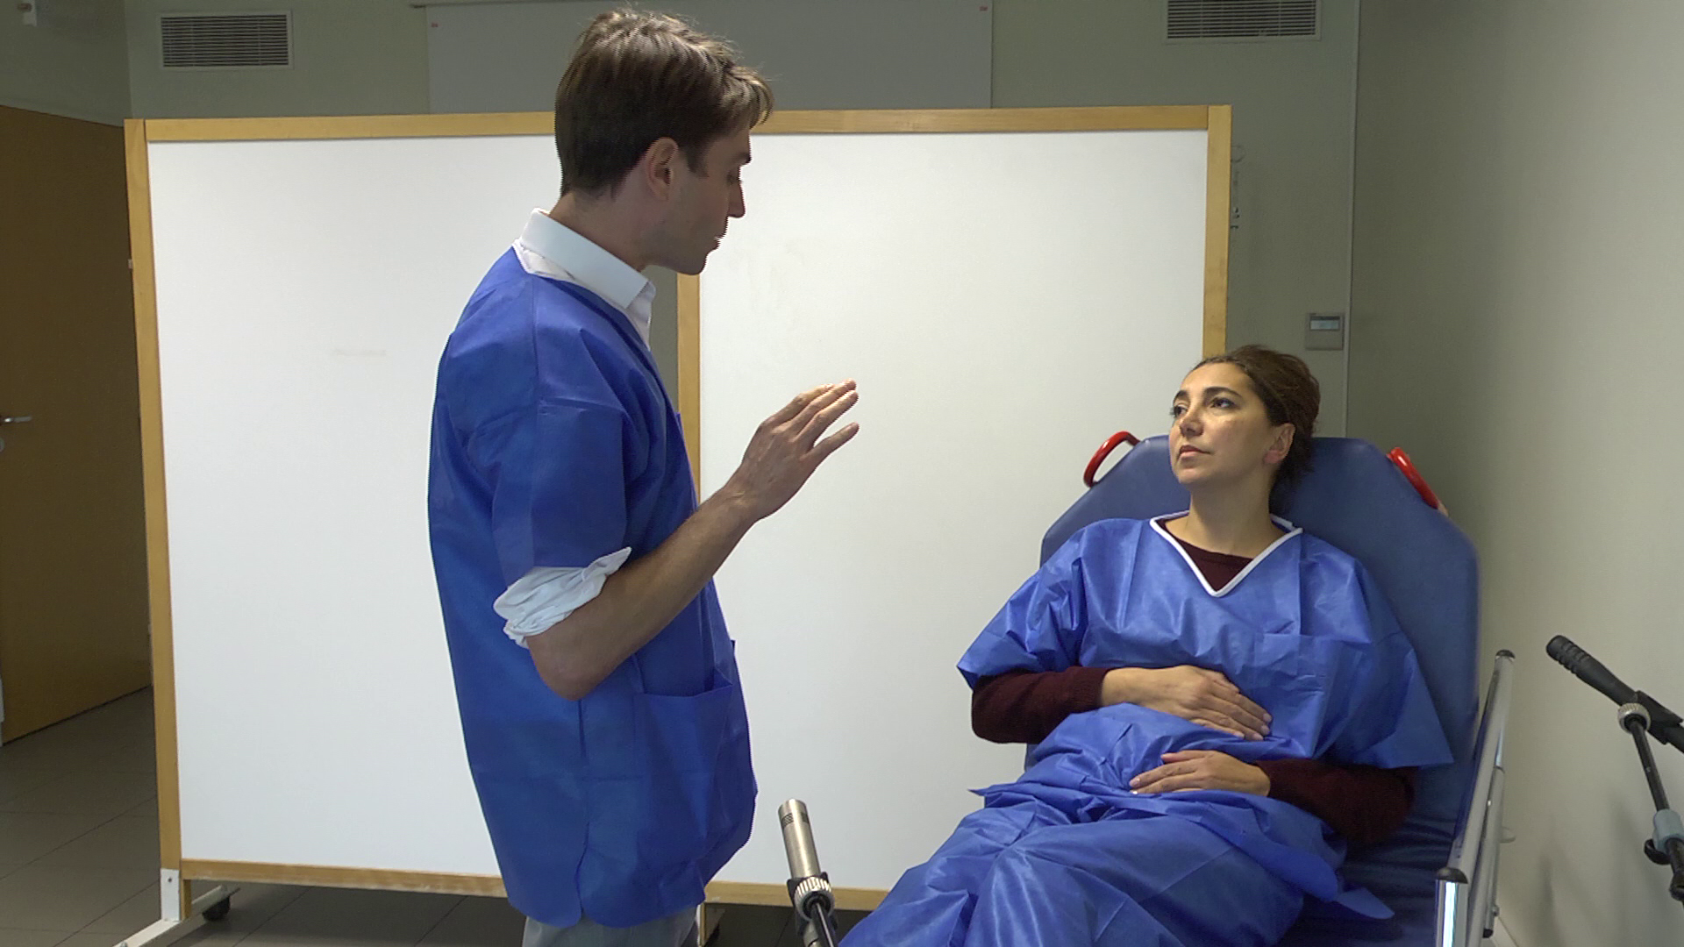
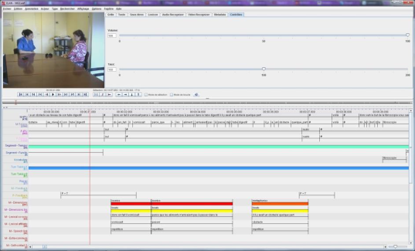
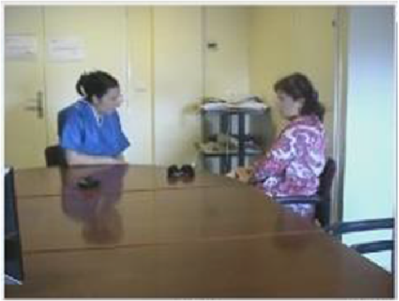


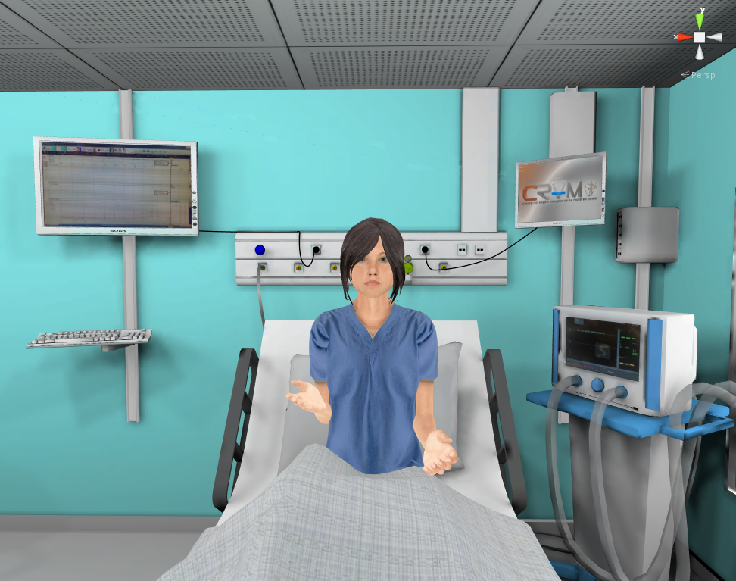




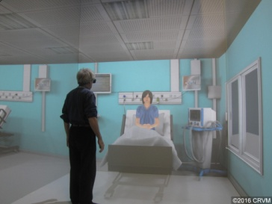
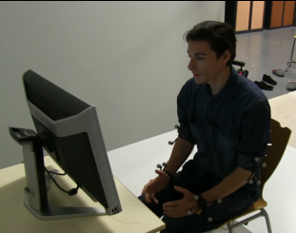
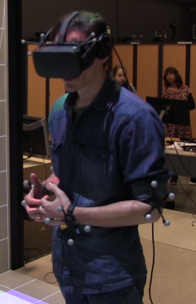
A Semi-autonomous System for Creating a Human-Machine Interaction Corpus in Virtual Reality: Application to the ACORFORMed System for Training Doctors to Break Bad News
Magalie Ochs, Philippe Blache, Grégoire de Montcheuil, Jean-Marie Pergandi, Jorane Saubesty, Daniel Francon, and Daniel Mestre
Virtual reality environment
with an autonomous virtual patient
Interdisciplinary approach
Collected corpus of human-human interaction
Real training sessions to train doctors to break bad news
with standardized patients (actors)
2 hours of audiovisual corpus (13 videos, 9mn/video)
Multimodal semi-manual annotation of the corpus
Verbal behavior: manual transcription, automatic annotation of medical terms and morpho-syntax (adj, verbs, nouns)
Non-verbal behavior: manual annotation (k=0.63) head mvts, gestures, postures changes, gaze direction, eyebrow expressions, hand gestures, smiles
Corpus of doctor-patient interaction
Semi-autonomous platform
Experimenter simulates critical modules: speech recognition & comprehension module
Tool to select among 136 prototypical sentences (defines based on the corpus)
Others modules are automatic
Approach ≠ Wizard of oz (select virtual agent’s reaction)
Autonomous virtual reality
training platform
Semi-autonomous virtual reality
training platform
Behavior model of the virtual patient
Dialog model based on a “common ground” implemented in OpenDial
Non-verbal behaviors library with specific breaking bad news gestures
Multimodal feedbacks behavior based on sequence mining corpus analysis
+
Corpus used to develop the autonomous system
To train the speech recognition system
To build the comprehension module
To validate the dialog module
To compare participants’ experiences depending on the device
Virtual reality displays with different immersive degrees
PC – VR headset – VR room
Corpus of human-machine interaction with different devices
Collected corpus of human-machine interaction
Corpus of 108 interactions (36 persons among which 10 doctors) – 6 hours (3mn16/interaction)
Tool developed for a 3D video playback of the interactions (with automatic replay of the tracked doctor’s non-verbal behavior)
Tags on videos with presence subjective experience of the participants (IPQ post-experience questionnaire)

